Slide 1

Memory
Chapter 6

Slide 2
Chapter 6 Learning Objective Menu
LO 6.1 Memory and the three processes of memory
LO 6.2 Different models of how memory works
LO 6.3 Sensory memory
LO 6.4 Short-term or working memory
LO 6.5 Long-term memory
LO 6.6 Different types of long-term memory
LO 6.7 How information is organized in long-term memory
LO 6.8 Kinds of cues that help people remember
LO 6.9 How recall and recognition differ
LO 6.10 Reliability of eye witness testimony
LO 6.11 Flashbulb memory
LO 6.12 How long-term memories are formed
LO 6.13 Problems experienced with remembering a long-term memory
LO 6.14 False memory syndrome
LO 6.15 Different causes of forgetting
LO 6.16 How and where memories are formed in the brain
LO 6.17 Amnesia
LO 6.18 Helping people with Alzheimer’s disease

Slide 3
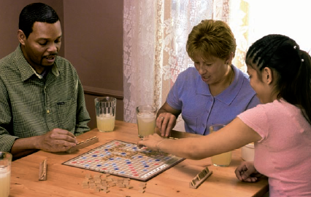
Memory and Its Processes
LO 6.1 Memory and the three processes of memory
Memory - an active system that receives information from the senses, organizes and alters it as it stores it away, and then retrieves the information from storage.
Processes of Memory:
      Encoding - the set of mental operations that people perform on sensory information to convert that information into a form that is usable in the brain’s storage systems.
      Storage - holding onto information for some period of time.
      Retrieval - getting information that is in storage into a form that can be used.
Menu

Slide 4
Models of Memory
LO 6.2 Different models of how memory works
Information-processing model - model of memory that assumes the processing of information for memory storage is similar to the way a computer processes memory in a series of three stages.
  Levels-of-processing model - model of memory that assumes information that is more “deeply processed,” or processed according to its meaning rather than just the sound or physical characteristics of the word or words, will be remembered more efficiently and for a longer period of time.
  Parallel distributed processing (PDP) model - a model of memory in which memory processes are proposed to take place at the same time over a large network of neural connections.
Menu

Slide 5
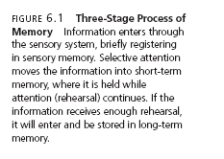
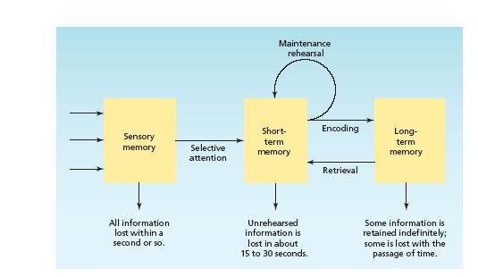
LO 6.2 Different models of how memory works
Menu

Slide 6
Sensory Memory
LO 6.3 Sensory memory
Sensory memory - the very first stage of memory, the point at which information enters the nervous system through the sensory systems.
  Iconic memory - visual sensory memory, lasting only a fraction of a second.
    Capacity – everything that can be seen at one time.
    Duration - information that has just entered iconic memory will be pushed out very quickly by new information, a process called masking.
    Eidetic imagery - the rare ability to access a visual memory for 30 seconds or more.
Menu

Slide 7
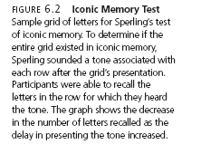
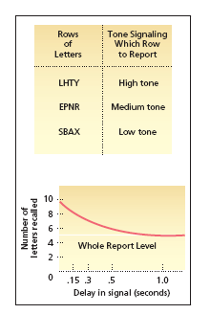
LO 6.3 Sensory memory
Menu

Slide 8

Sensory Memory
LO 6.3 Sensory memory
  Echoic memory - the brief memory of something a person has just heard.
    Capacity - limited to what can be heard at any one moment and is smaller than the capacity of iconic memory
    Duration – lasts longer that iconic — about 2 to 4 seconds
Menu

Slide 9
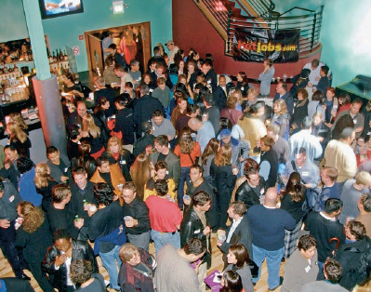
Short-Term Memory
LO 6.4 Short-term or working memory
Short-term memory (STM) (working memory) - the memory system in which information is held for brief periods of time while being used.
  Selective attention – the ability to focus on only one stimulus from among all sensory input.
Menu

Slide 10
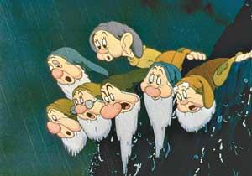
Short-Term Memory
LO 6.4 Short-term or working memory
Digit-span test – memory test in which a series of numbers is read to subjects in the experiment who are then asked to recall the numbers in order.
  Conclusions are that the capacity of STM is about seven items or pieces of information, plus or minus two items, or from five to nine bits of information.
      “magical number” = 7
Chunking – bits of information are combined into meaningful units, or chunks, so that more information can be held in STM.
Menu

Slide 11


Short-Term Memory
LO 6.4 Short-term or working memory
Maintenance rehearsal - practice of saying some information to be remembered over and over in one’s head in order to maintain it in short-term memory (STMs tend to be encoded in auditory form).
Duration of STM - lasts from about 12 to 30 seconds without rehearsal.
STM is susceptible to interference
(e.g., if counting is interrupted,
have to start over).
Menu

Slide 12
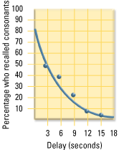
LO 6.4 Short-term or working memory
Menu

Slide 13
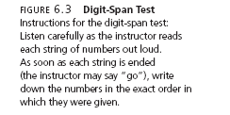
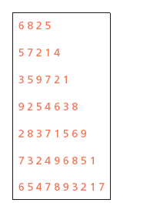
LO 6.4 Short-term or working memory
Menu

Slide 14
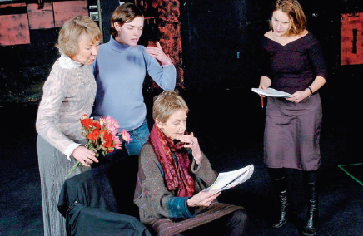
Long-Term Memory
LO 6.5 Long-term memory
Long-term memory (LTM) - the system of memory into which all the information is placed to be kept more or less permanently.
Elaborative rehearsal - a method of transferring information from STM into LTM by making that information meaningful in some way.
Menu

Slide 15
Types of LTM
LO 6.6 Different types of long-term memory
Procedural (nondeclarative) memory - type of long-term memory including memory for skills, procedures, habits, and conditioned responses. These memories are not conscious but are implied to exist because they affect conscious behavior.
Declarative memory – type of long-term memory containing information that is conscious and known (memory for facts).
Menu

Slide 16

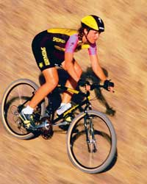
Procedural (Nondeclarative) LTM
LO 6.6 Different types of long-term memory
Skills that people know how to do.
Also include emotional associations, habits, and simple conditioned reflexes that may or may not be in conscious awareness.
Anterograde amnesia - loss of memory from the point of injury or trauma forward, or the inability to form new long-term memories. Usually does NOT affect procedural LTM.
Procedural memory often called implicit memory - memory that is not easily brought into conscious awareness.
Menu

Slide 17
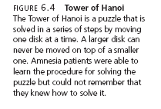
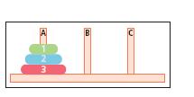
LO 6.6 Different types of long-term memory
Menu

Slide 18
Declarative LTM
LO 6.6 Different types of long-term memory
All the things that people know.
Semantic memory - type of declarative memory containing general knowledge, such as knowledge of language and information learned in formal education.
Episodic memory - type of declarative memory containing personal information not readily available to others, such as daily activities and events.
Semantic and episodic memories are forms of explicit memory - memory that is consciously known.
Menu

Slide 19
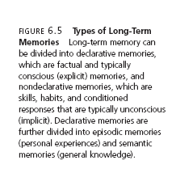
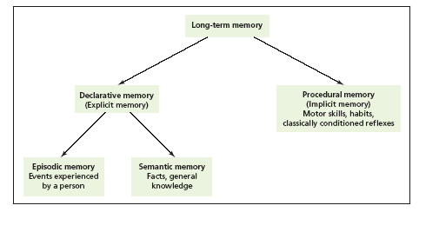
LO 6.6 Different types of long-term memory
Menu

Slide 20
Organization of Memory
LO 6.7 How information is organized in long-term memory
LTM organized in terms of related meanings and concepts.
Semantic network model - model of memory organization that assumes information is stored in the brain in a connected fashion, with concepts that are related stored physically closer to each other than retrieval cue a stimulus for remembering.
Menu

Slide 21
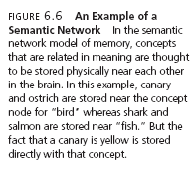
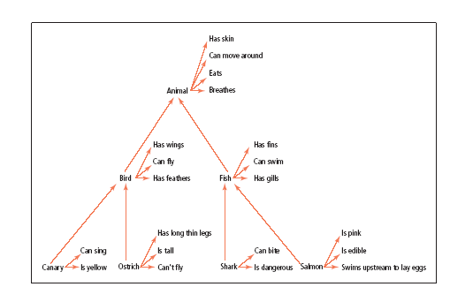
LO 6.7 How information is organized in long-term memory
Menu

Slide 22
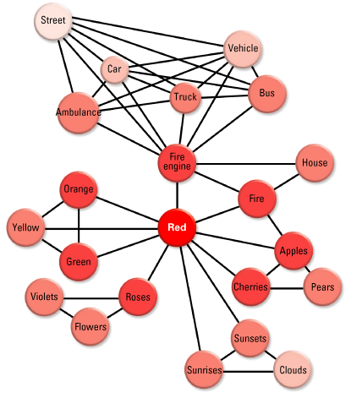
LO 6.7 How information is organized in long-term memory
Menu

Slide 23
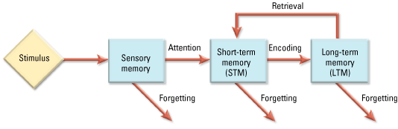
LO 6.7 How information is organized in long-term memory
Menu

Slide 24

Cues to Help Remember
LO 6.8 Kinds of cues that help people remember
Retrieval cue – a stimulus for remembering.
Encoding specificity - the tendency for memory of information to be improved if related information (such as surroundings or physiological state) available when the memory is first formed is also available when the memory is being retrieved.
  State-dependent learning - memories formed during a particular physiological or psychological state will be easier to recall while in a similar state.
Menu

Slide 25
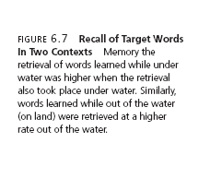
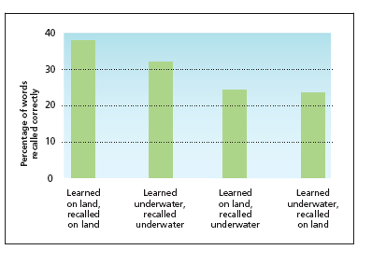
LO 6.8 Kinds of cues that help people remember
Menu

Slide 26
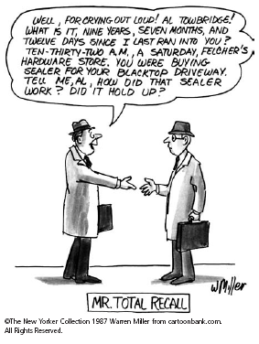
Recall
LO 6.9 How recall and recognition differ
Recall - type of memory retrieval in which the information to be retrieved must be “pulled” from memory with very few external cues.
  Retrieval failure – recall has failed (at least temporarily).
    Tip of the tongue phenomenon.
Menu

Slide 27

Recall
LO 6.9 How recall and recognition differ
Serial position effect - tendency of information at the beginning and end of a body of information to be remembered more accurately than information in the middle of the body of information.
  Primacy effect - tendency to remember information at the beginning of a body of information better than the information that follows.
  Recency effect - tendency to remember information at the end of a body of information better than the information ahead of it.
Menu

Slide 28
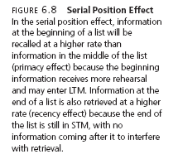
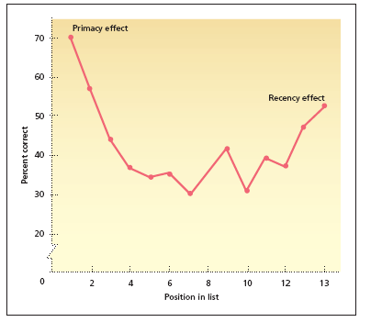
LO 6.9 How recall and recognition differ
Menu

Slide 29
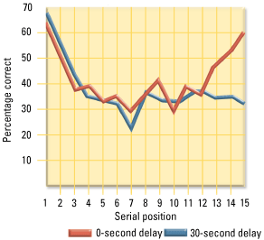
LO 6.9 How recall and recognition differ
Menu

Slide 30
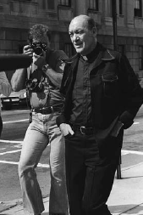
Recognition
LO 6.9 How recall and recognition differ
Recognition - the ability to match a piece of information or a stimulus to a stored image or fact.
False positive – error of recognition in which people think that they recognize some stimulus that is not actually in memory.
Father Bernard Pagano enters a
courthouse during his time as a suspect
in a series of robberies. He was falsely
identified for the crimes committed by
another man, who eventually confessed
to the robberies. False positives occur
when people mistakenly believe they
have recognized someone or something
that they have actually never seen.
Menu

Slide 31
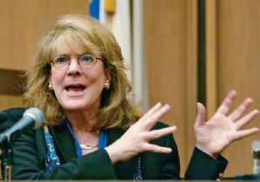
Eyewitness Testimony
LO 6.10 Reliability of eye witness testimony
Elizabeth Loftus study.
  Showed that what people see and hear about an event after the fact can easily affect the accuracy of their memories of that event.
  Eye witness testimony not always reliable.
Menu

Slide 32
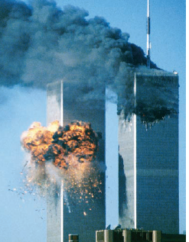
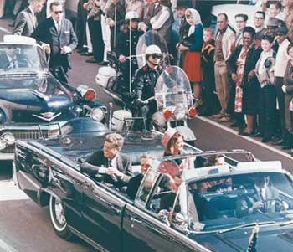
Automatic Encoding and Flashbulb Memories
LO 6.11 Flashbulb memory
Automatic encoding - tendency of certain kinds of information to enter long-term memory with little or no effortful encoding.
Flashbulb memories - type of automatic encoding that occurs because an unexpected event has strong emotional associations for the person remembering it.
Menu

Slide 33
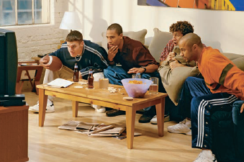
How LTMs Are Formed
LO 6.12 How long-term memories are formed
“. . . remembering is more like making up a story than it is like reading one printed in a book.”
Constructive processing - referring to the retrieval of memories in which those memories are altered, revised, or influenced by newer information.
Hindsight bias - the tendency to falsely believe, through revision of older memories to include newer information, that one could have correctly predicted the outcome of an event.
Monday morning quarterbacking – hindsight bias
Menu

Slide 34
Memory Retrieval Problems
LO 6.13 Problems experienced with remembering a long-term memory
Misinformation effect - the tendency of misleading information presented after an event to alter the memories of the event itself.
Menu

Slide 35
Reliability of Memory Retrieval
LO 6.14 False memory syndrome
False memory syndrome - the creation of inaccurate or false memories through the suggestion of others, often while the person is under hypnosis.
Evidence suggests that false memories cannot be created for just any kind of memory.
  The memories must at least be plausible.
Menu

Slide 36
Forgetting
LO 6.15 Different causes of forgetting
Curve of forgetting - a graph showing a distinct pattern in which forgetting is very fast within the first hour after learning a list and then tapers off gradually.
Menu

Slide 37
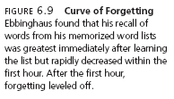
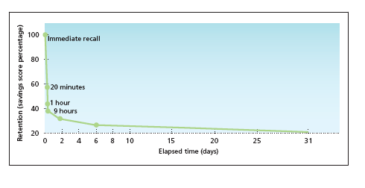
LO 6.15 Different causes of forgetting
Menu

Slide 38
Forgetting: Encoding Failure
LO 6.15 Different causes of forgetting
Encoding failure - failure to process information into memory.
Menu

Slide 39
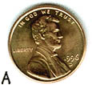
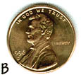
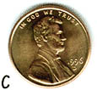
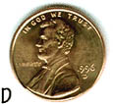
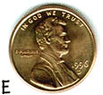
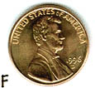
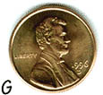
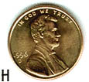
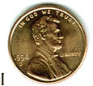
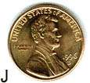
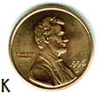
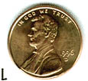
Encoding Failure:
Which is the correct penny?
It’s me!
Menu

Slide 40
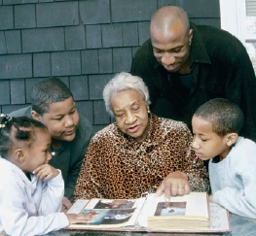
Forgetting: Memory Trace Theory
LO 6.15 Different causes of forgetting
Memory trace - physical change in the brain that occurs when a memory is formed.
  Decay - loss of memory due to the passage of time, during which the memory trace is not used.
  Disuse - another name for decay, assuming that memories that are not used will eventually decay and disappear.
Memories after many years – not explained by memory trace theory.
Menu

Slide 41

Forgetting: Interference Theory
LO 6.15 Different causes of forgetting
Proactive interference - memory retrieval problem that occurs when older information prevents or interferes with the retrieval of newer information.
Retroactive interference - memory retrieval problem that occurs when newer information prevents or interferes with the retrieval of older information.
Proactive interference – problem driving in England after learning in US.
Menu

Slide 42
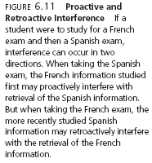
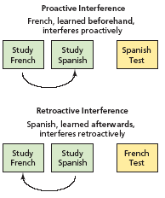
LO 6.15 Different causes of forgetting
Menu

Slide 43
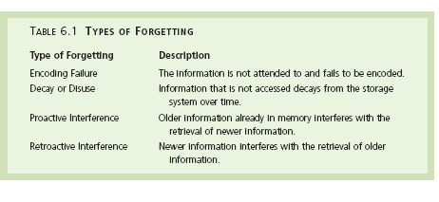
LO 6.15 Different causes of forgetting
Menu

Slide 44
Formation of LTMs
LO 6.16 How and where memories are formed in the brain
Engram - the physical change that takes place in the brain when a memory is formed.
Consolidation - the changes that take place in the structure and functioning of neurons when an engram is formed.
Hippocampus – area of brain responsible for the formation of LTMs.
Menu

Slide 45
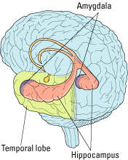
LO 6.16 How and where memories are formed in the brain
Menu

Slide 46
Amnesia
LO 6.17 Amnesia
Retrograde amnesia - loss of memory from the point of some injury or trauma backwards, or loss of memory for the past.
Anterograde amnesia - loss of memory from the point of injury or trauma forward, or the inability to form new long-term memories (“senile dementia”).
Infantile amnesia - the inability to retrieve memories from much before age 3.
  Autobiographical memory - the memory for events and facts related to one’s personal life story (usually after age 3).
Menu

Slide 47


LO 6.17 Amnesia
Menu

Slide 48

Alzheimer’s Disease
LO 6.18 Helping people with Alzheimer’s disease
The primary memory difficulty in Alzheimer’s is anterograde amnesia, although retrograde amnesia can also occur as the disease progresses.
There are various drugs in use or in development for use in slowing or stopping the progression of Alzheimer’s disease.
Menu

Slide 49

LO 6.18 Helping people with Alzheimer’s disease
Menu

